Slide 1
Anglia Ruskin University
School of Computing and Information Science
Machine Learning in Finance
MOD 009701
Week 2: Introduction to Machine Learning in Finance
Dr Vitaliy Milke
PhD in Computer Science and Machine Learning
MSc in Computer Science
MSc in Rocket Engineering
vitaliy.milke@aru.ac.uk
vmilke@gmail.com

Slide 2
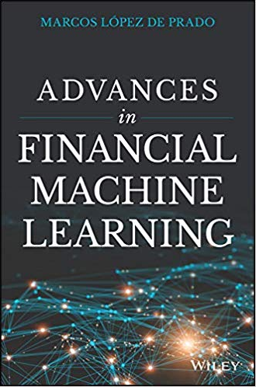
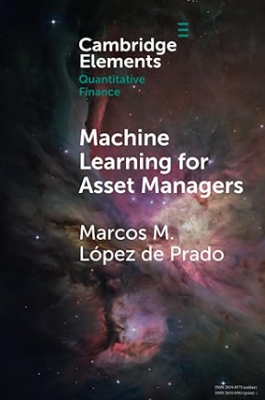
Machine Learning in Finance
MOD 009701
Literature
Dr Marcos M. López de Prado

Slide 3
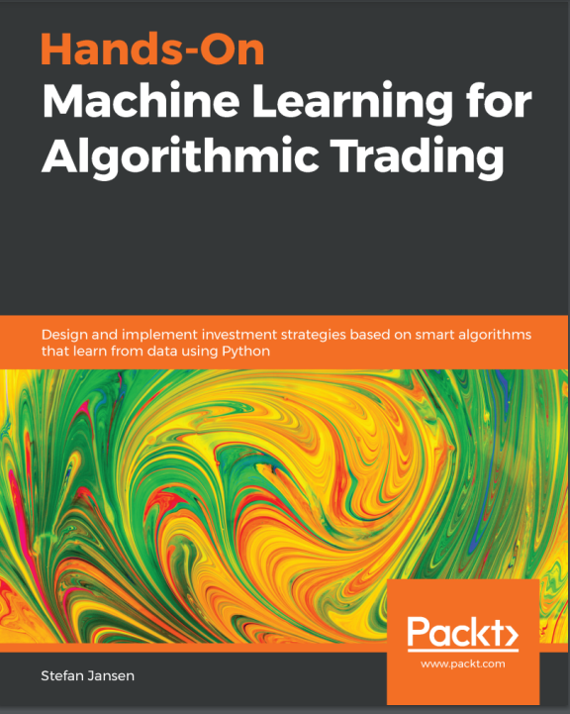
Machine Learning in Finance
MOD 009701
Literature
Stefan Jansen

Slide 4

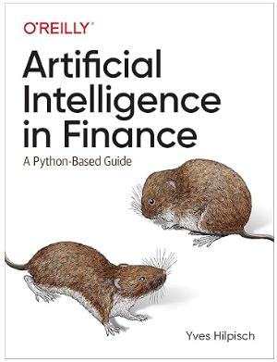
Machine Learning in Finance
MOD 009701
Literature
Dr Yves Hilpisch

Slide 5
Machine Learning in Finance
MOD 009701
Machine Learning in Finance
What is the difference between
typical (classical) machine learning
and Machine Learning in Finance?

Slide 6
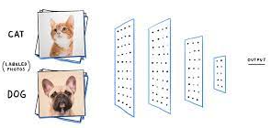
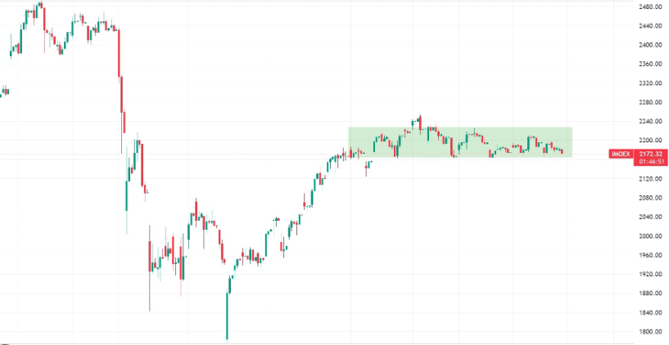
Machine Learning in Finance
MOD 009701
Machine Learning problems in Finance
Classical Machine Learning methods have not been developed for financial applications and financial datasets
As opposed to pattern recognition, a human cannot easily evaluate whether the financial model is working correctly or not
?

Slide 7
Machine Learning in Finance
MOD 009701
Machine Learning problems in Finance
lack of data and / or bad (excluding stock market); challenge to separate test and training sets
problem to visualise; having noisy data; simple cross-validation does not work
central banks do not play GO
Data
Evaluation of the result
Single shot problem

Slide 8
Machine Learning in Finance
MOD 009701
Machine Learning problems in Finance
Bad model - Good back test
The algorithm will always find a structure in the data even if it is not there (if you torture the data for a long time, it will admit to anything)
Multiple back test is like password guessing by searching all combinations (With this approach, we will recognise the correct one (winner) However, it is useless to select the next password

Slide 9


Machine Learning in Finance
MOD 009701
Machine Learning in Finance, Advantages
Advantages
You should not be an Olympic champion in Machine Learning in Finance.

Slide 10

Machine Learning in Finance
MOD 009701
Machine Learning in Finance, Advantages
Advantages
You should not be an Olympic champion in Machine Learning in Finance.
51%
is enough

Slide 11
Machine Learning in Finance
MOD 009701
Machine Learning in Financem, Advantages
1% per day

Slide 12
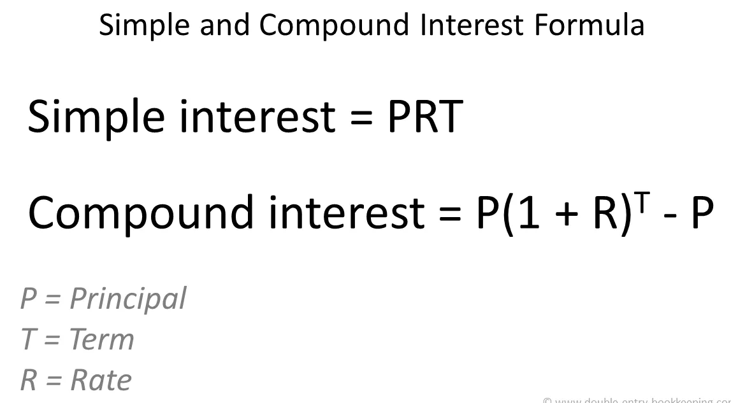
Machine Learning in Finance
MOD 009701
Simple and Compound Interests
Simple and Compound Interest Formulas:

Slide 13
Machine Learning in Finance
MOD 009701
Simple and Compound Interests
Simple and Compound Interest Formulas:
= P x 0.01 x 250
250
= P (1 x 0.01) - P

Slide 14
Machine Learning in Finance
MOD 009701
Simple and Compound Interests
Simple and Compound Interest Formulas:
= P x 0.01 x 250
= P x 2.5
= P x 11.03
250
= P (1 x 0.01) - P

Slide 15
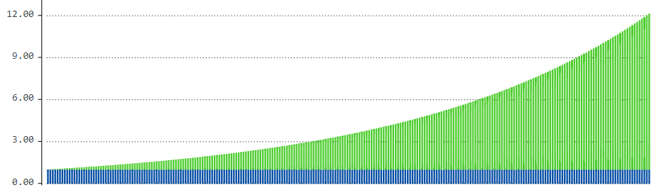
Machine Learning in Finance
MOD 009701
Simple and Compound Interests
Simple and Compound Interest Formulas:
12.0
= P x 2.5
= P x 11.03
3.5
- Initial investment amount (Principal)
1 year

Slide 16
Machine Learning in Finance
MOD 009701
Technical Specifications for Machine Learning in Trading.
Important conclusions:
1) Short-term trading is potentially more profitable than long-term trading, in case it is successful.
2) For successful trading, it is enough to win a little bit every day (for example, 1 or 2%), but it is essential to do it constantly.
3) It is more important not to win a lot, but not to lose more, or to lose less often and a little bit (i.e., to reduce risks).

Slide 17
Machine Learning in Finance
MOD 009701
Technical Specifications for Machine Learning in Trading.
Important conclusions:
Why do most new investors lose in the stock markets?
Mainly because they do not follow these principles.
1) Short-term trading is potentially more profitable than long-term trading, in case it is successful.
2) For successful trading, it is enough to win a little bit every day (for example, 1 or 2%), but it is essential to do it constantly.
3) It is more important not to win a lot, but not to lose more, or to lose less often and a little bit (i.e., to reduce risks).

Slide 18
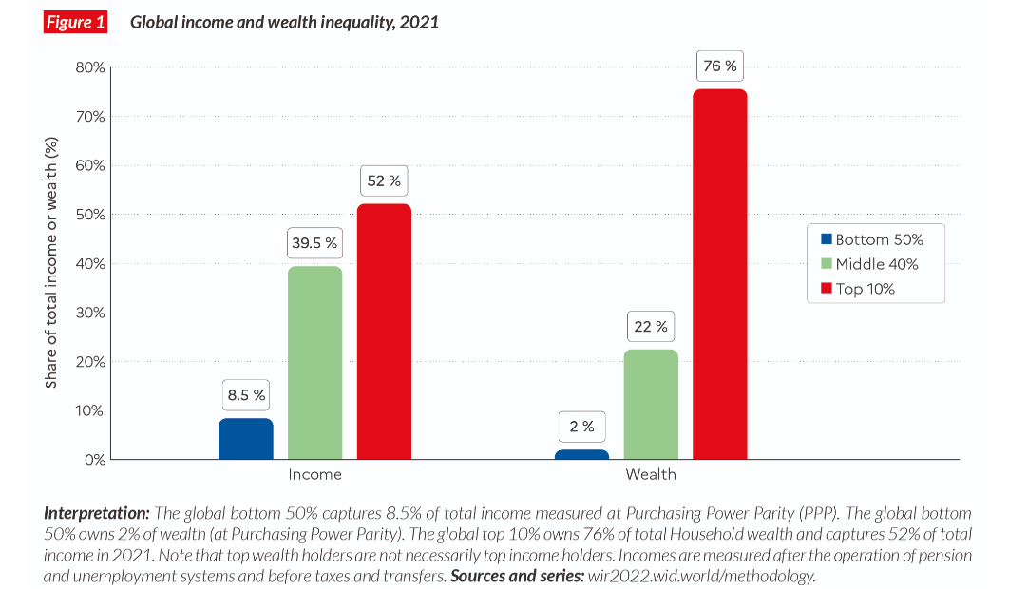
Machine Learning in Finance
MOD 009701
Global Income Inequality
https://wir2022.wid.world/executive-summary/

Slide 19
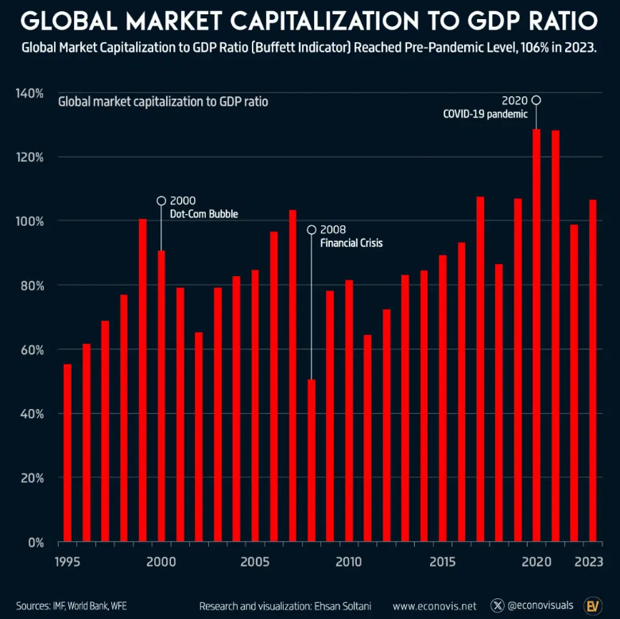


Machine Learning in Finance
MOD 009701
Global Financial Market VS GDP
Financial Market
GDP
https://www.econovis.net

Slide 20
Machine Learning in Finance
MOD 009701
Global Financial Market VS GDP
Financial Market
GDP
https://www.econovis.net

Slide 21
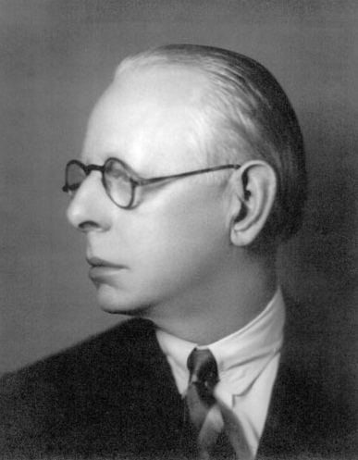
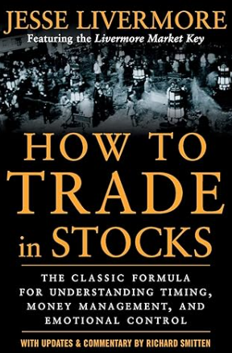
Machine Learning in Finance
MOD 009701
Play or job?
You can play in the financial market only if your goal is not to win.
To win in the stock market, it must be your job.
Jesse Lauriston Livermore (1877 – 1940)

Slide 22
Machine Learning in Finance
MOD 009701
A dream
How do many fresh analysts imagine algorithmic trading?
To Earn
It's Enough
The actual reality is much more complex!

Slide 23
Machine Learning in Finance
MOD 009701
Machine Learning VS.
Financial Market
Being a Kaggle.com winner is not enough

Slide 24

Machine Learning in Finance
MOD 009701
Machine Learning VS.
Financial Market
The most famous Machine Learning task
Dog ?
Cat ?

Slide 25

Machine Learning in Finance
MOD 009701
Machine Learning VS.
Financial Market
Dog ?
Cat ?

Slide 26
Machine Learning in Finance
MOD 009701
Machine Learning VS.
Financial Market
Typical Machine Learning task in Finance
Up
?
Down

Slide 27
Machine Learning in Finance
MOD 009701
Machine Learning VS.
Financial Market
VS.

Slide 28


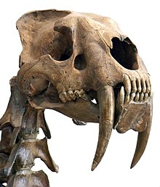
Machine Learning in Finance
MOD 009701
Machine Learning VS.
Financial Market
VS.
Saber-toothed tiger (Smilodon)
Wolf

Slide 29
Machine Learning in Finance
MOD 009701
Machine Learning VS.
Financial Market
dogs and cats have been changed significantly from Smilodon’s time
dogs and cats have mostly stayed the same in 10 years
30,000 year ago, (Smilodon’s Time)
2015, Revolution in Convolutional Neural Networks
Today
Time

Slide 30
Machine Learning in Finance
MOD 009701
Machine Learning VS.
Financial Market
patterns of financial market participants’ behaviours are constantly changing.
dogs and cats have been changed significantly from Smilodon’s time
VS.
dogs and cats have mostly stayed the same in 10 years
Time
30,000 year ago, (Smilodon Time)
2015, Revolution in Convolutional Neural Networks
Today

Slide 31
Machine Learning in Finance
MOD 009701
NumPy VS Pandas
NumPy
(Numeric Python)
Pandas
(Panel Data)
VS.

Slide 32

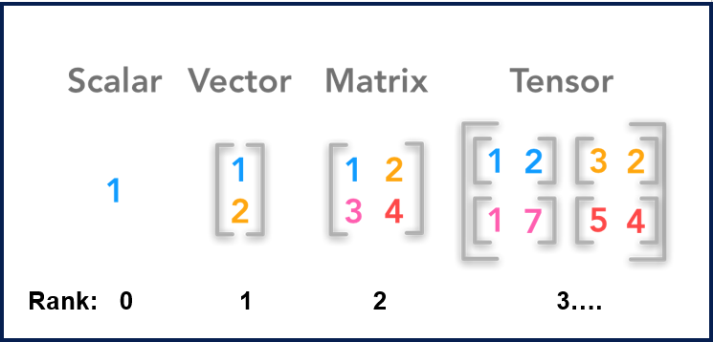
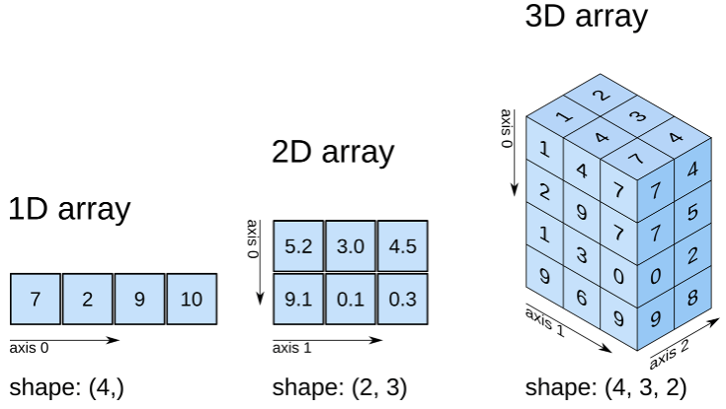
Machine Learning in Finance
MOD 009701
NumPy VS Pandas
Numeric arrays

Slide 33
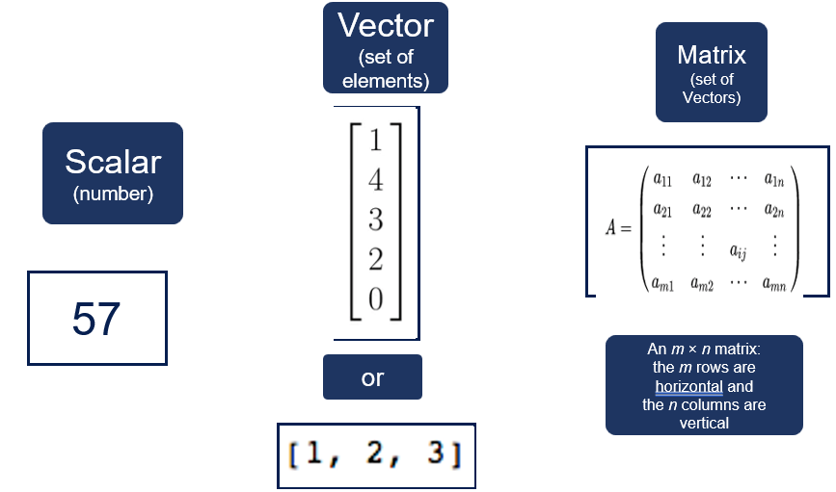
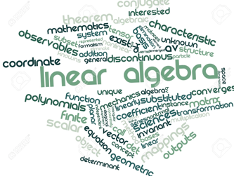
Machine Learning in Finance
MOD 009701
NumPy VS Pandas

Slide 34
Machine Learning in Finance
MOD 009701
NumPy VS Pandas
manipulates numeric matrixes (arrays)
NumPy
(Numeric Python)

Slide 35
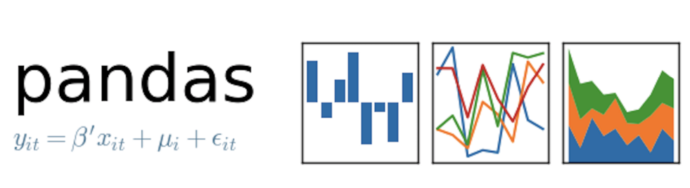
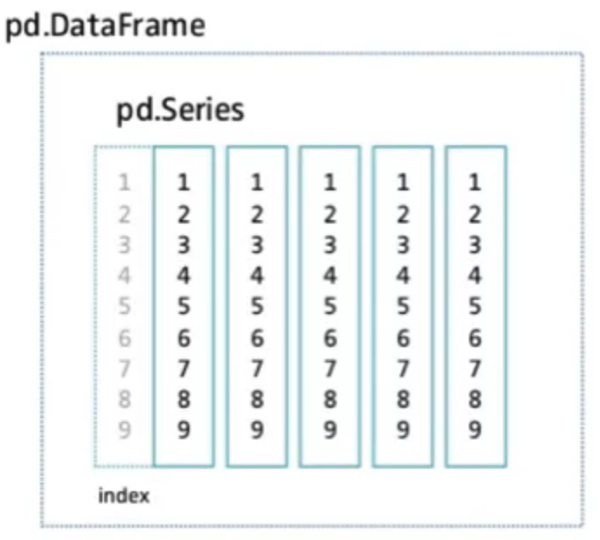
Machine Learning in Finance
MOD 009701
NumPy VS Pandas

Slide 36
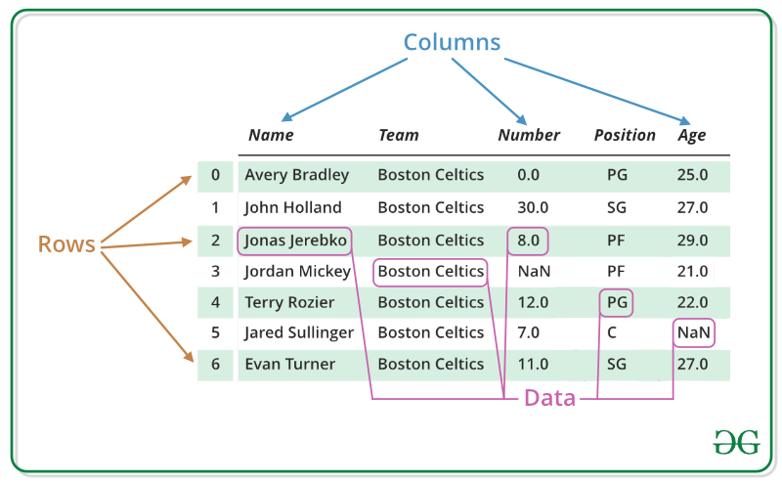
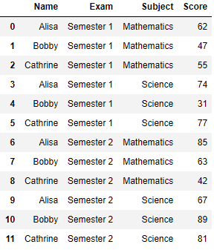
Machine Learning in Finance
MOD 009701
NumPy VS Pandas

Slide 37
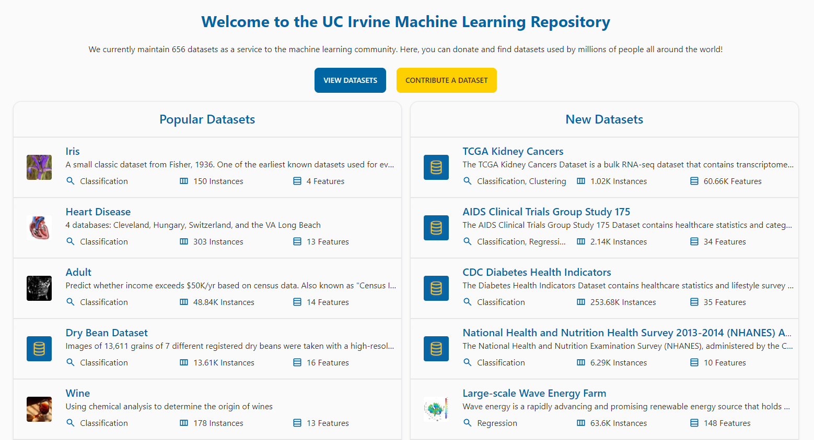
Machine Learning in Finance
MOD 009701
UCI Machine Learning Repository
The UCI Machine Learning Repository is a collection of databases. It consists of natural and synthetic databases in the fields of biology, medicine, physics, technology, and sociology that the machine-learning community uses for the empirical analysis of machine-learning algorithms.
Source: https://archive.ics.uci.edu/

Slide 38
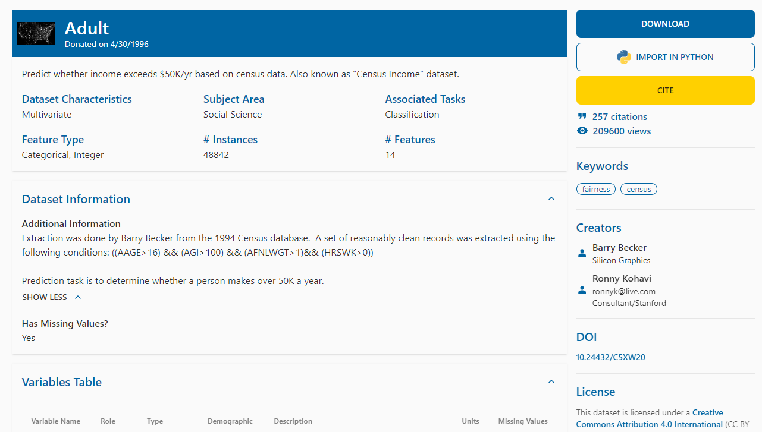
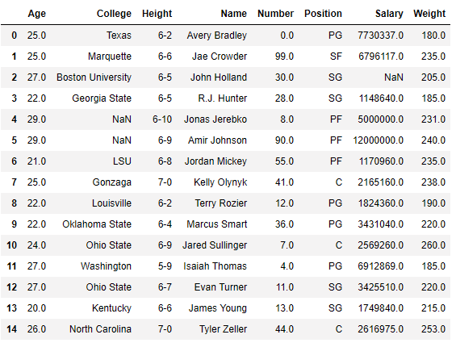
Machine Learning in Finance
MOD 009701
Adult Data Set
cvcsource
cvcsource
Extraction was done by Barry Becker from the 1994 Census database.
Source: http://archive.ics.uci.edu/ml/datasets/Adult

Slide 39
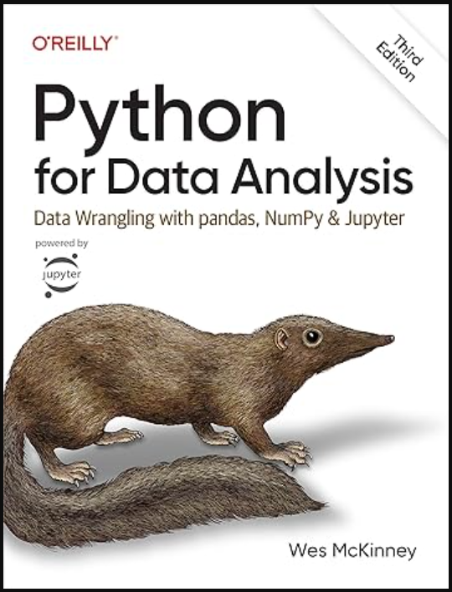
Machine Learning in Finance
MOD 009701
Literature
Additional Information:
https://pandas.pydata.org/
https://pandas.pydata.org/pandas-docs/stable/
https://github.com/guipsamora/pandas_exercises/

